Slide 1
Welcome to bioinformatics
Jorge Batista da Rocha
Education Developer
Vaishnavi Vikas Gangadhar
Informatics Technical Officer
Martin Aslett
Informatics Manager
Alice Matimba
Head of Global Training and Capacity Development
Welcome Connecting Science
Learning and Training

Slide 2

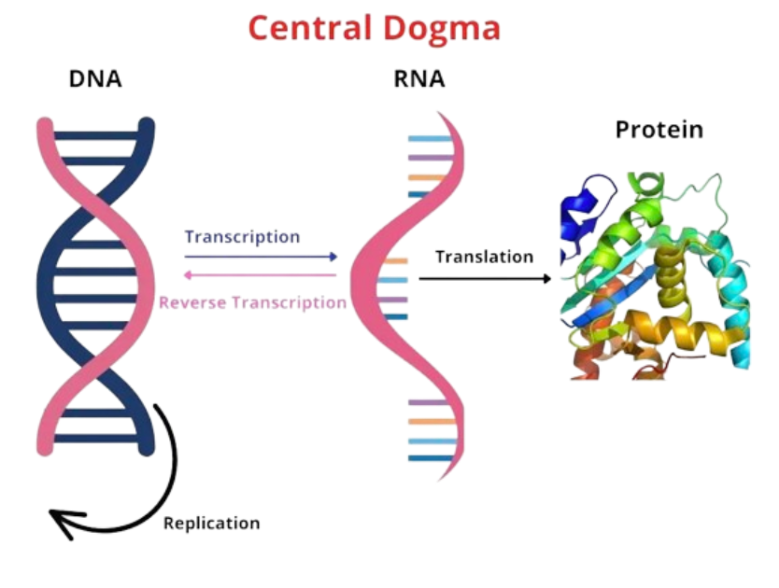
Genomics - in a nutshell
Why is it so important?
What makes us who we are?
Helps us improve quality of life:
Identifying new species of plants & animals.
Curing dangerous and life threatening diseases like Cancer.
Discovery of new medicines.
Other known applications: Agriculture, Ecosystem study, Environment, Food Industry and many more.
DNA molecule that contains the genetic code that is unique to every individual.
Image Taken from CollegeDunia/CentralDogmaArticle

Slide 3
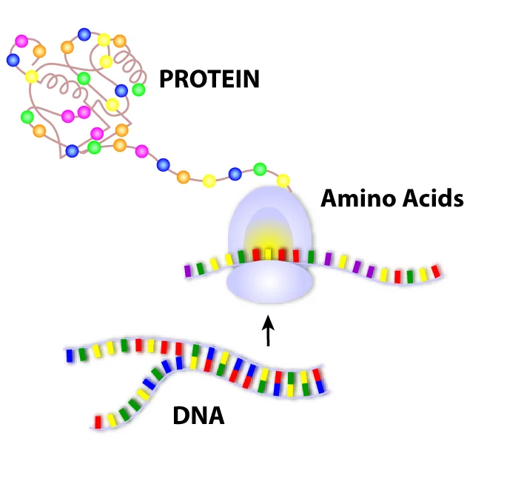
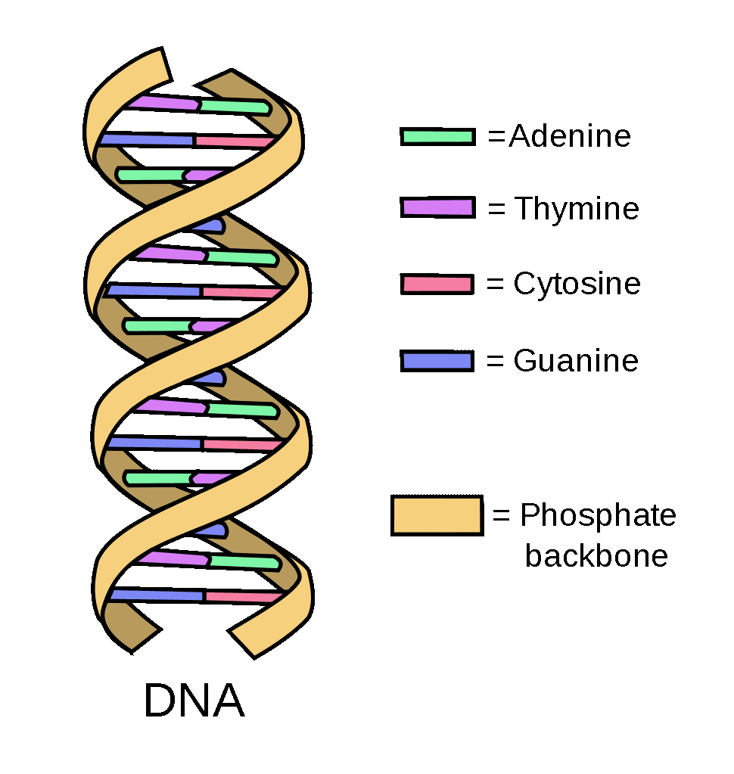
DNA & Protein Structure Refresher
RNA
Image Taken from https://www.ashg.org/discover-genetics/building-blocks/ and https://learn.genetics.utah.edu/content/basics/dnacodes

Slide 4
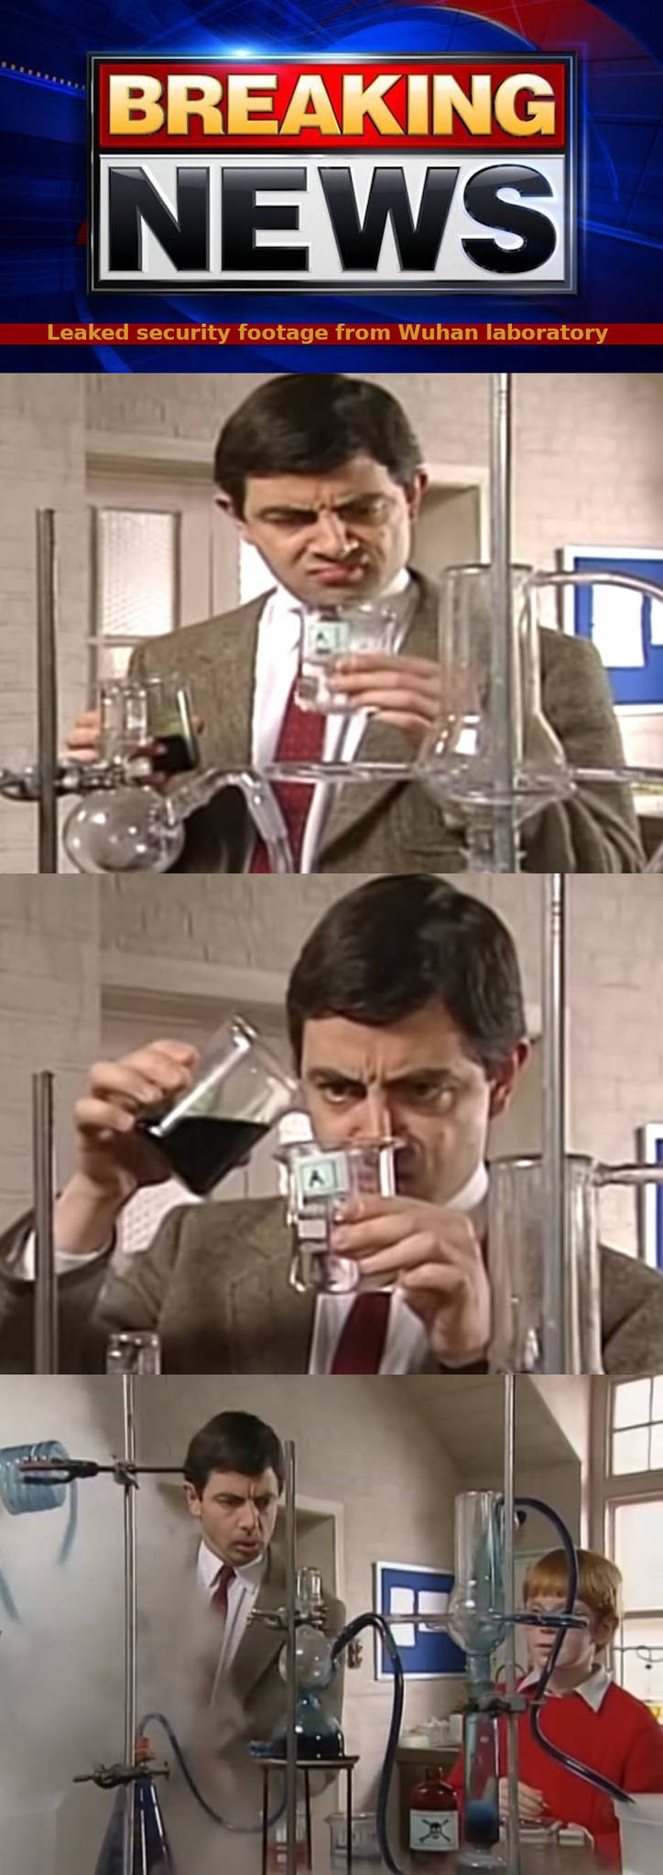
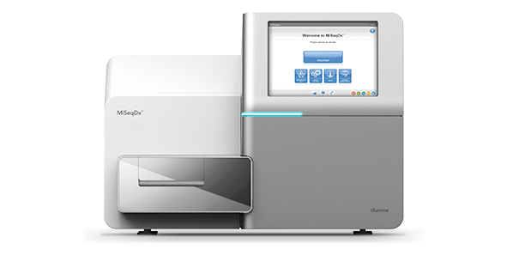
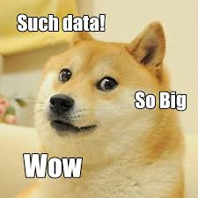
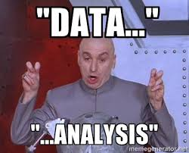

Generate Data (reads physical data to text ATGC data)
Wet Lab Team working very hard!
Here comes the Bioinformaticians…
Image Taken from Left Side Memes, DNA Sequencer, Top Right Meme, Bottom Left Meme and Bottom Right Meme.

Slide 5
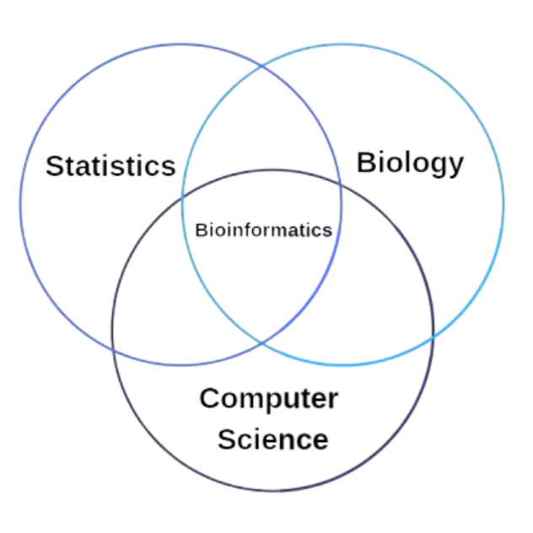
What is Bioinformatics?
Solving problems arising from biology using methodology from computer science
Biochemistry
Cell Biology
Human Genetics
Microbiology
Virology
Plant Biology
And many more…
Essential Mathematics
Statistical Methods and Testing
Programming Languages (Python, R, Java)
Working with Databases
Machine Learning and Artificial Intelligence
Credits for Venn Diagram for Bioinformatics

Slide 6

Workshop Aims
AKA things to add to your resume later :p
Explore genomic data types
Use linux based commands to process data
Practice using online tools to analyse sequencing data
Understand basic concepts in sequence alignment
Investigate evolutionary links in taste receptors
Image Taken from https://www.multivu.com/players/English/8563651-bushs-beans-duke-spokes-dog-instagram-petcon/

Slide 7


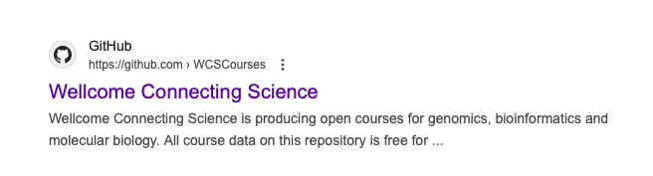
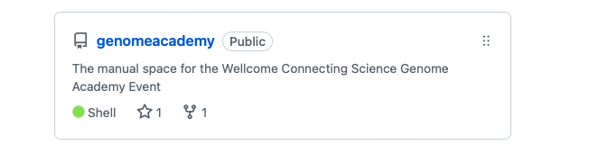
Part 1 - Introduction to Linux and Blasting
Open Firefox browser and go to:
https://wcscourses.github.io/genomeacademy
https://wcscourses.github.io/genomeacademy

Slide 8
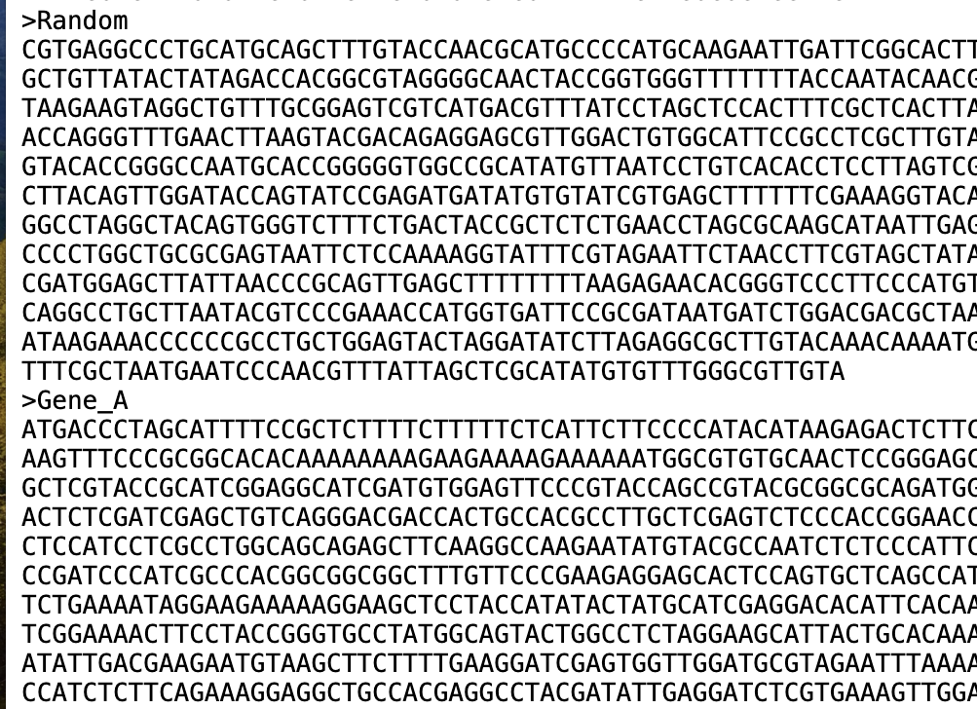
Task 1: Unmixing up of the Genes
Step 1: Open Github > Save/Download the file.
Or
Open Terminal in your PC > wget command
Check? If file is in text format
Step 2: Right click files and open them with Gedit, the text editor on your pc.
Where is the file? Click on File Manager and search.
Step 3: Copy (control c) and paste (control v) the lines for Gene A (both name and sequence) into the new gedit page. You can then save this file (control s) as Gene_A.fasta
Repeat again for Gene B
File Name: mIxUp_FiLe_hahahaha.fasta
What does .fasta mean? FAST-ALL
FASTA format is a text-based format for representing either nucleotide sequences or amino acid (protein) sequences.

Slide 9
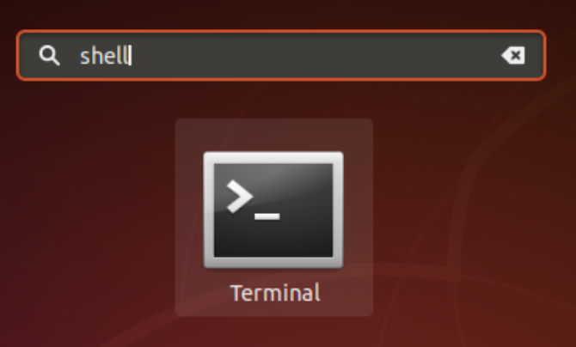
Task 2: Commands to help us get Genes out of the file
Step 1: Open Terminal
Step 2: Type command ls (small caps)
Check? Your saved file name should appear
Step 3: Run the grep command:
grep ">" mIxUp_FiLe_hahahaha.fasta
Note: Be careful to include the “” around the > in your command. If you don't, the > symbol is a command operator that writes outputs of commands to files.
Step 4: Now we want to get a specific gene out - run
grep ">Gene_A" -A1 mIxUp_FiLe_hahahaha.fasta
Step 5: Save the file using command
grep ">Gene_A" -A1 mIxUp_FiLe_hahahaha.fasta > Gene_A_command.fasta
Step 6: Repeat the commands for Gene B (hint - you can replace Gene_A with Gene_B)
Shortcut to open Terminal? Ctrl + Alt + T
What is a Terminal?
It is a middle man which allows users to interact with their computer's operating system.
What does command grep do? (full form: global regular expression print)
It is a useful command to search for matching patterns in a file

Slide 10

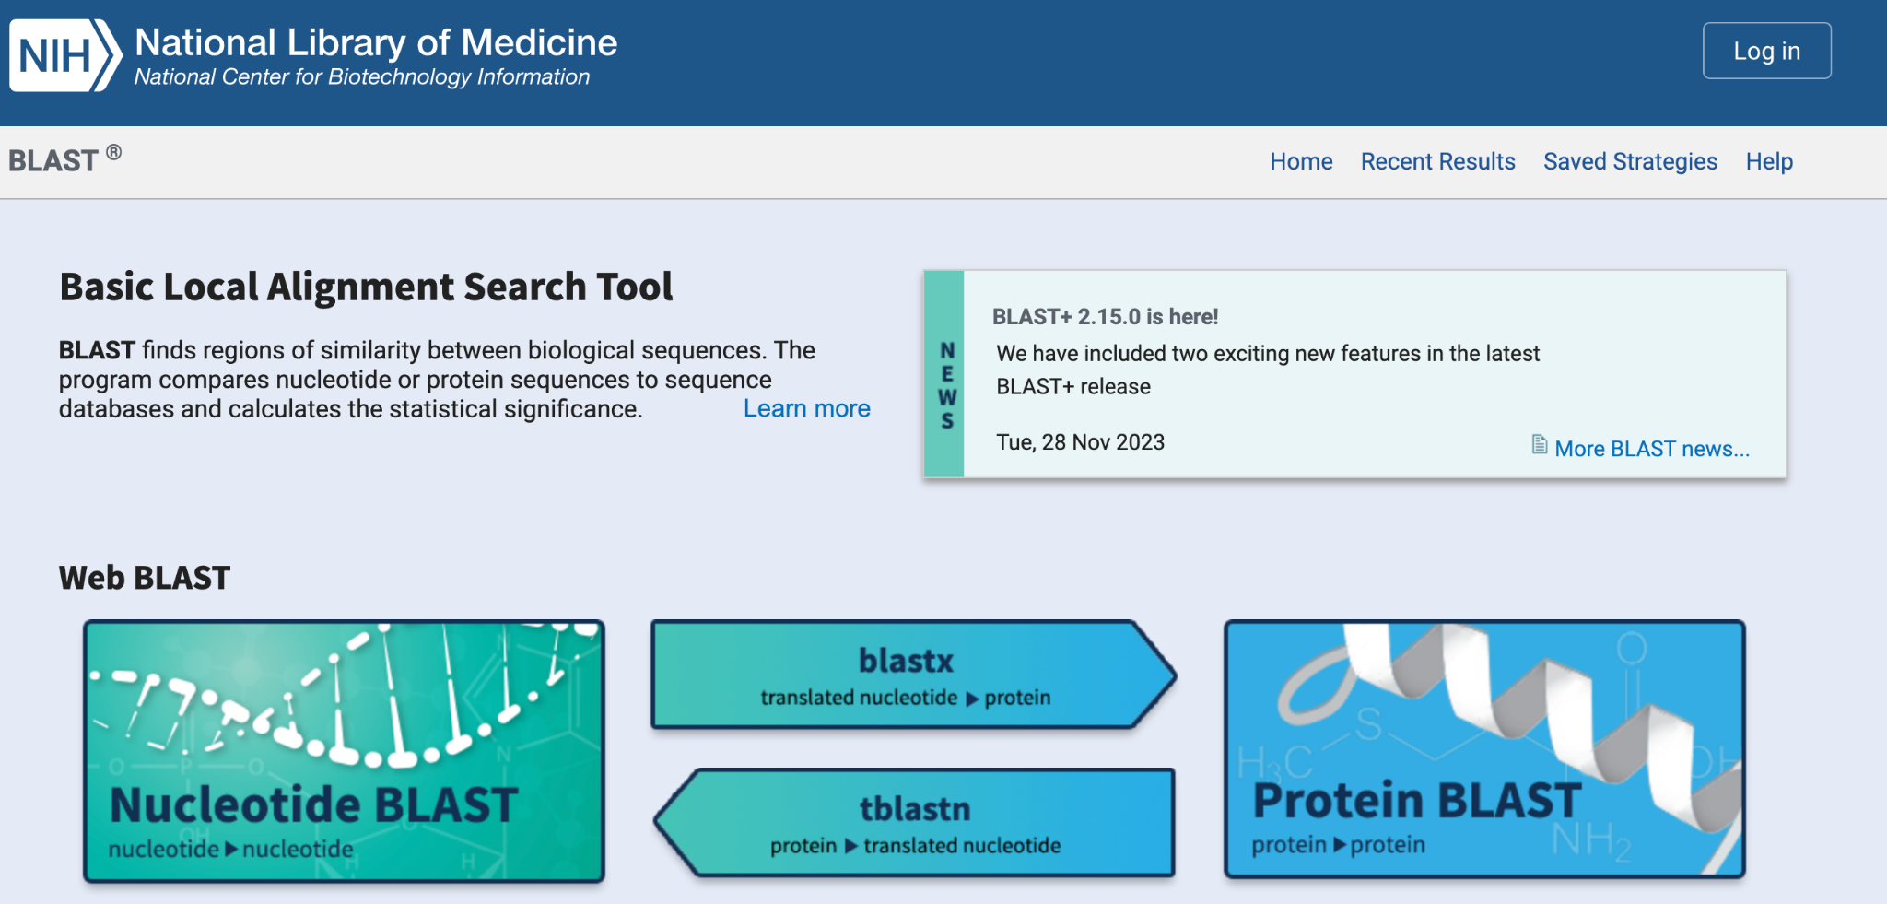
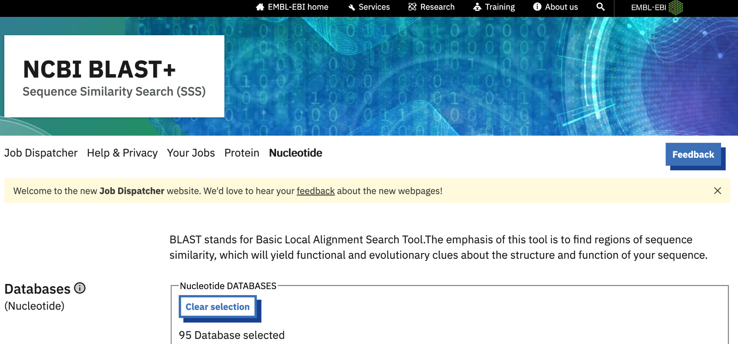
Task 3: Figure out which gene belongs to human or animal
Time to put on our “what would a bioinformatician do?” cap
What information does the data provide?
Get Data
(Gene A & Gene B)
Look up in our Bioinformatics Database

Slide 11
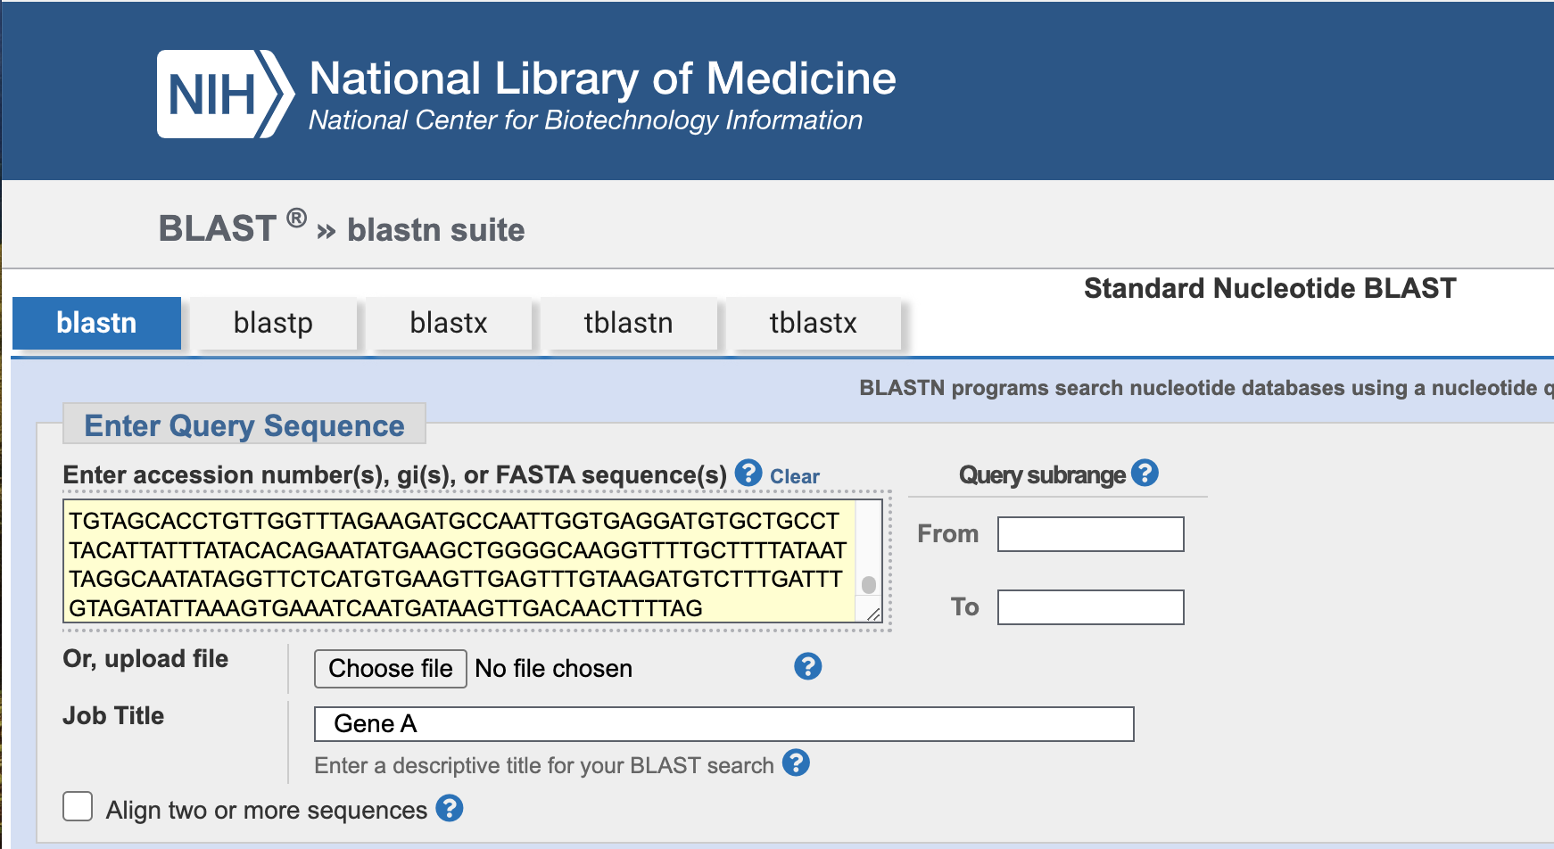
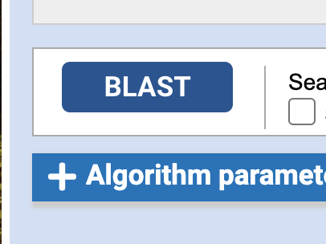
Bioinformatics Database: Processing Data
Step 1: In firefox search for NIH BLAST
Step 2: Select Nucleotide BLAST
Step 3: Enter sequence in Query box
IMPORTANT: Label the submitted jobs as Gene A and Gene B, so you don't get confused,
Step 4: Scroll to the bottom of webpage and click on BLAST (to submit job)
What is a BLAST and what does it do?
BLAST is an algorithm and program for comparing primary biological sequence information

Slide 12

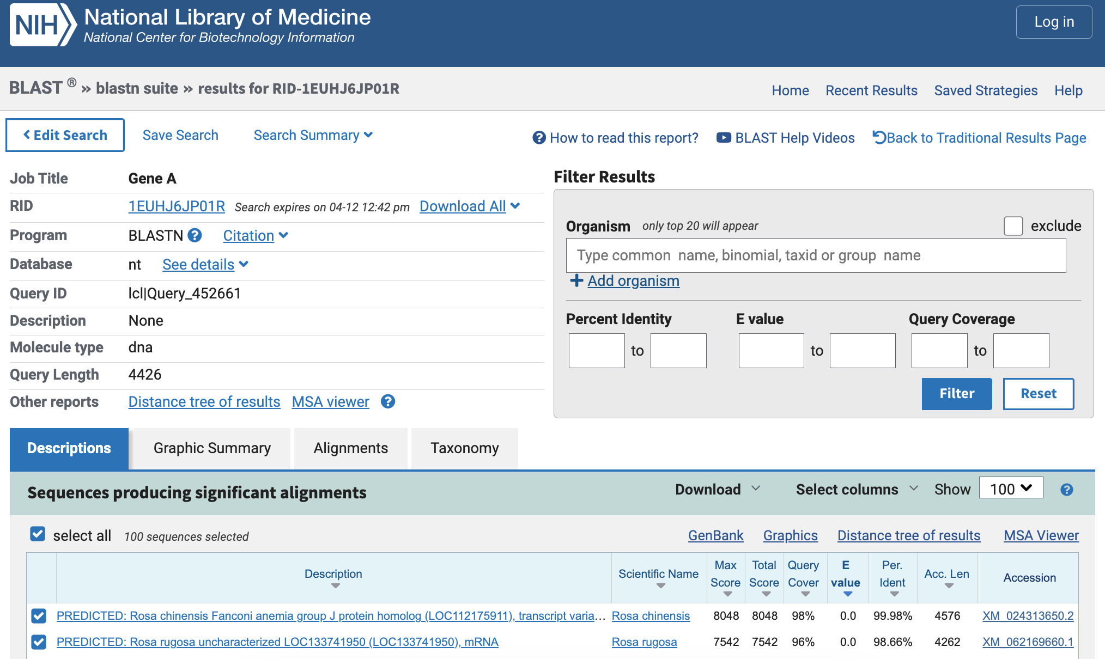
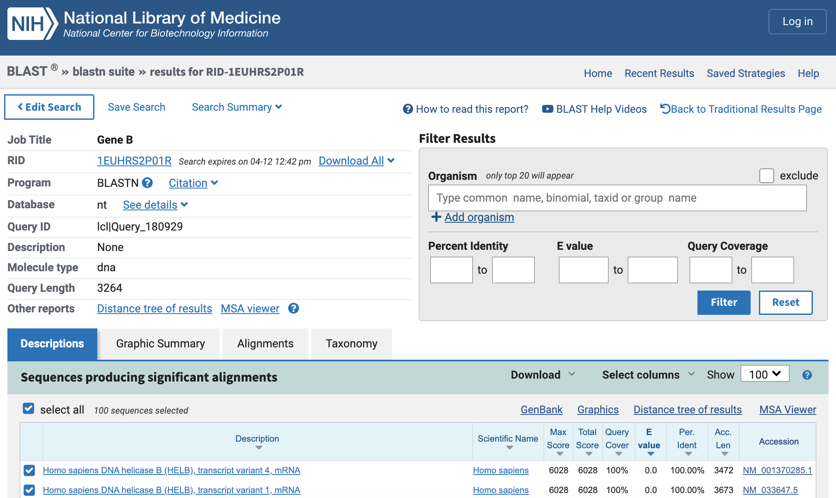

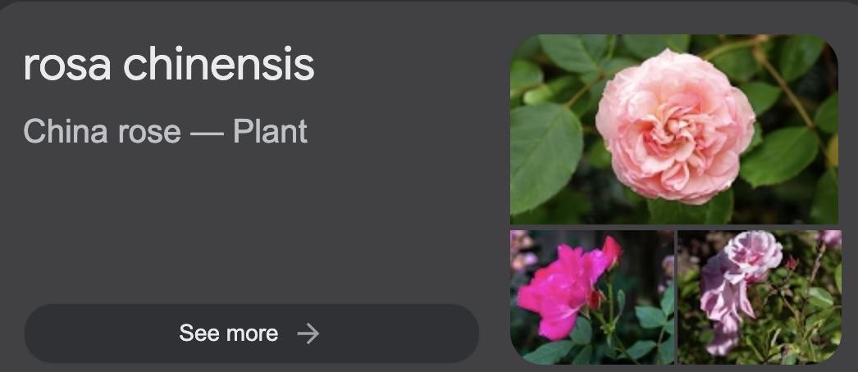
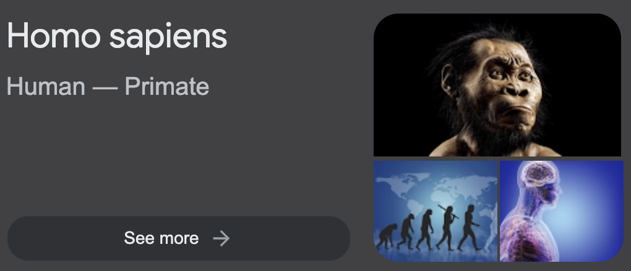
Bioinformatics Results
Gene A: Rosa chinensis
Gene B: Homo Sapiens

Slide 13
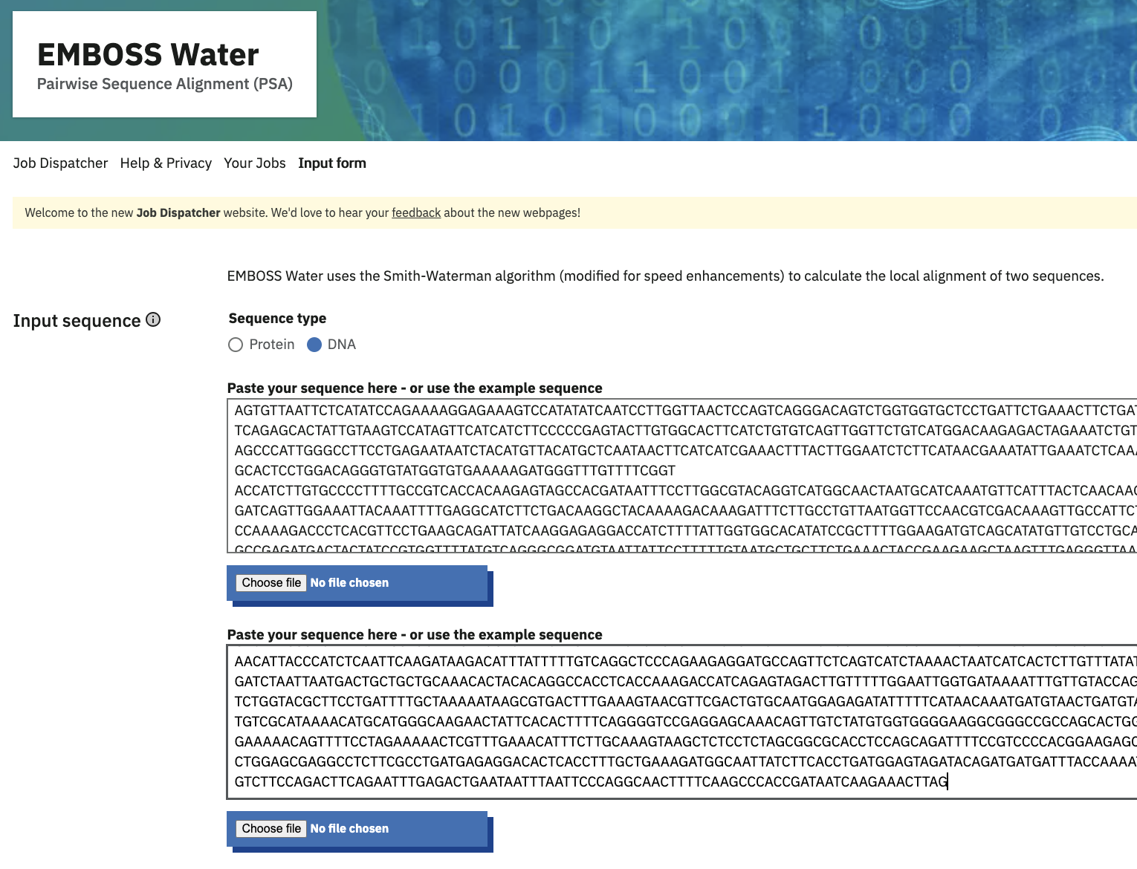
Task 4: Can we compare the two sequences?
Step 1: In Firefox browser search for EMBOSS
Step 2: Select Input as DNA, and enter Gene Sequences.
IMPORTANT: Label the submitted job.

Slide 14
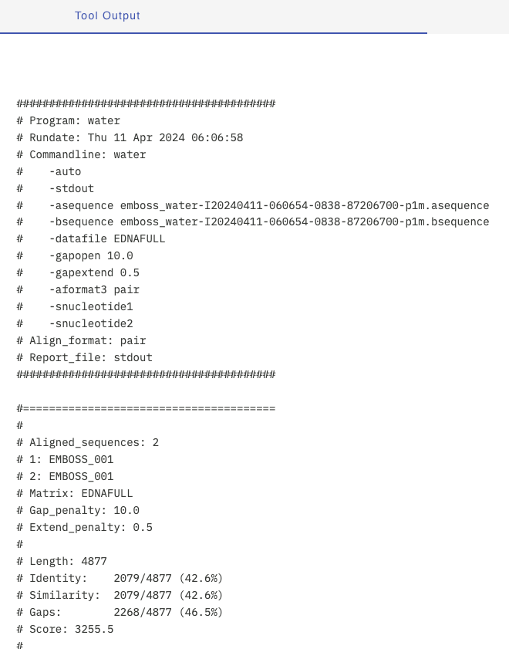
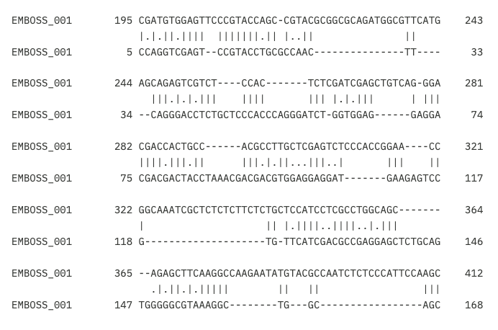
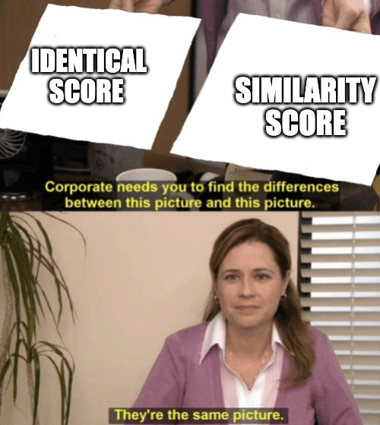
Task 4: Result
Gene A - Gene B
Mismatch
Gap
Match
Homologous
Identical
Similar
Similar Ancestry
Character (A-A, T-T) is said to be identical between two sequences.
Resemblance between two sequences when compared.
How many AT or CG contents match?
Analogous
Can be similar but due to convergent evolution
Meme Image Taken from https://imgflip.com/

Slide 15
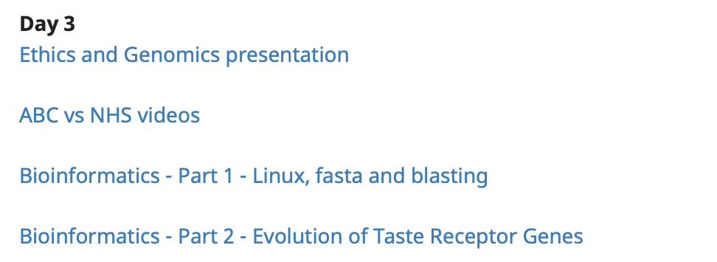
Part 2 - Taste Receptor Evolution
Open Firefox and go to:
https://wcscourses.github.io/genomeacademy
This tutorial has been modified from a tutorial delivered at Scifest Africa by:
Student Council of the South African Society for Bioinformatics - SASBI-sc
http://sasbistudents.weebly.com

Slide 16
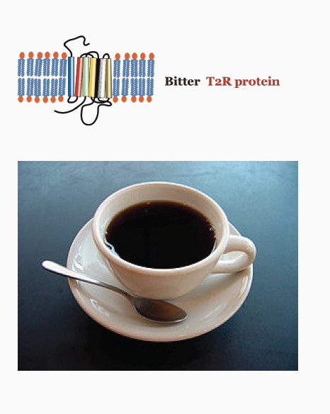
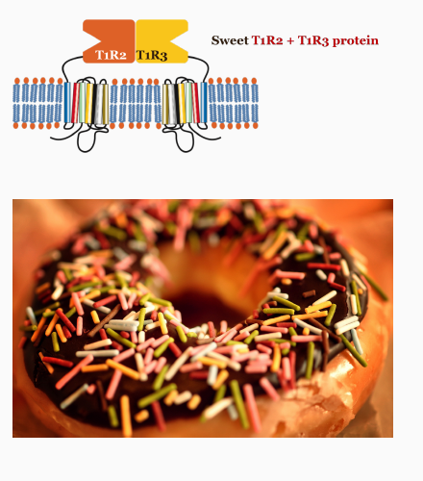
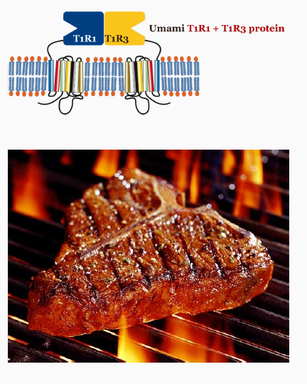
Taste receptor genes
T2R proteins
TAS2R genes
T1R3 and TIR2
TAS1R3 and TAS1R2
T1R3 and TIR1
TAS1R3 and TAS1R1

Slide 17
Evolution of taste receptors in animals
The aim of this task is to study the similarities between the amino acid
sequences of T1R (sweetness and umami) taste receptor proteins.
This will allow you to investigate how new taste receptors evolve.

Slide 18
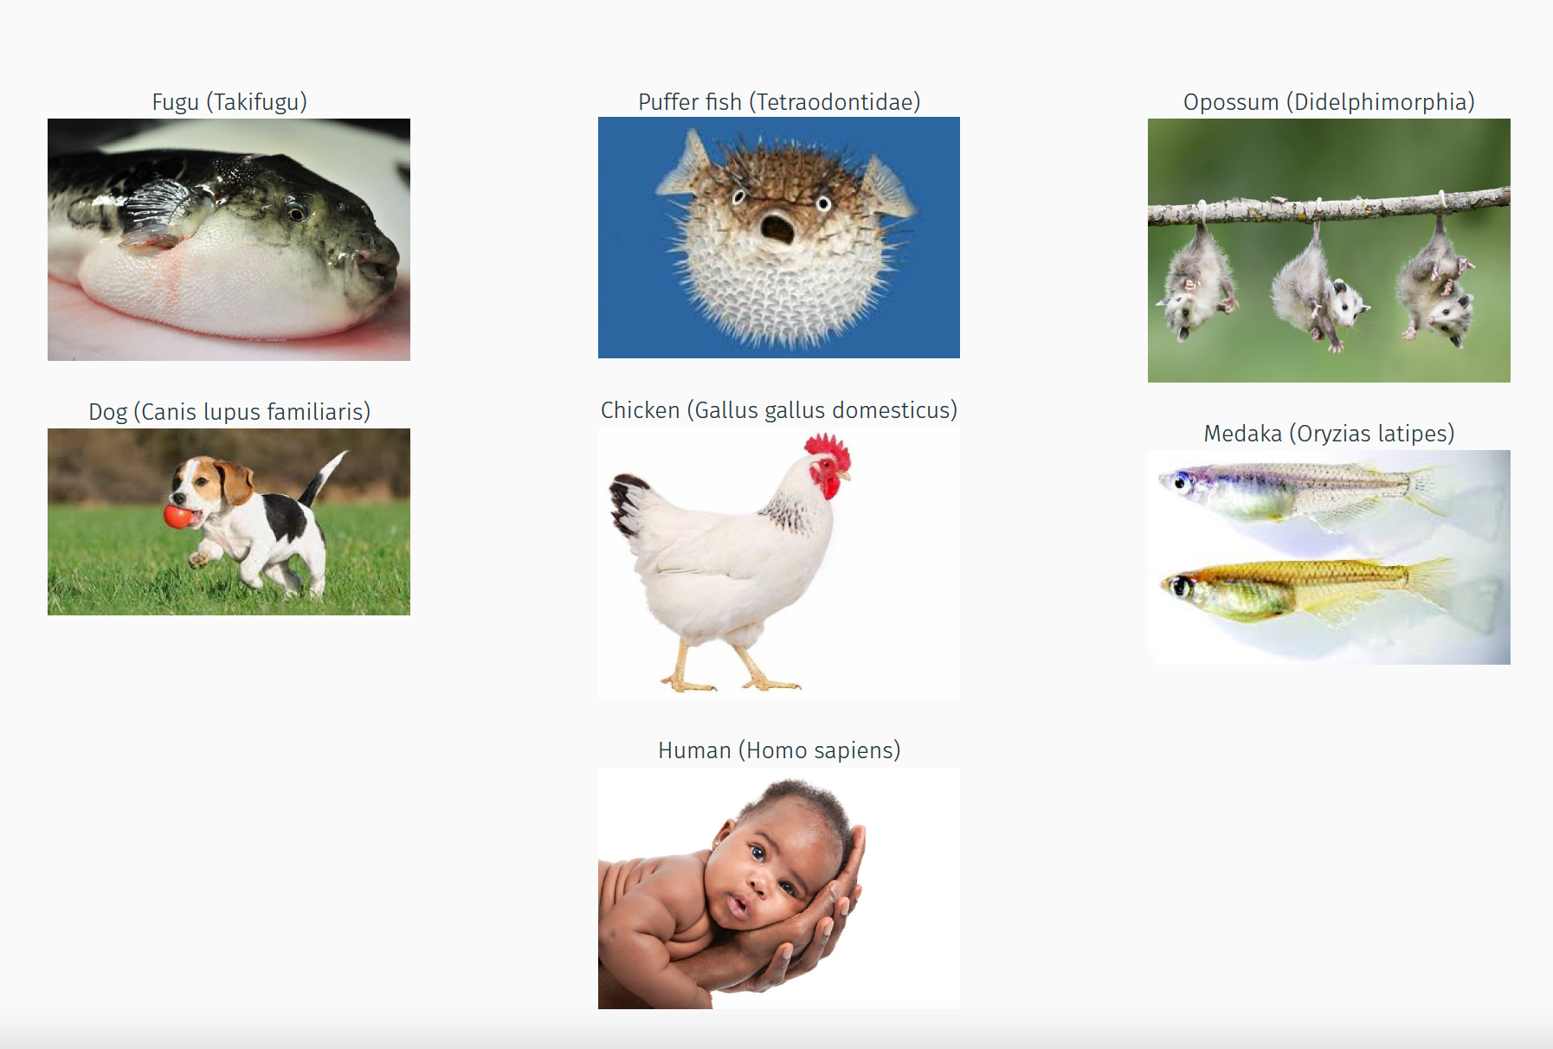

Slide 19
Results!

Slide 20
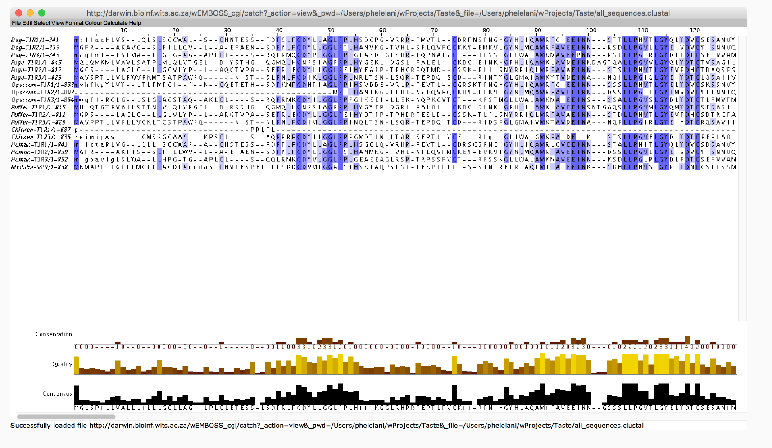

Slide 21
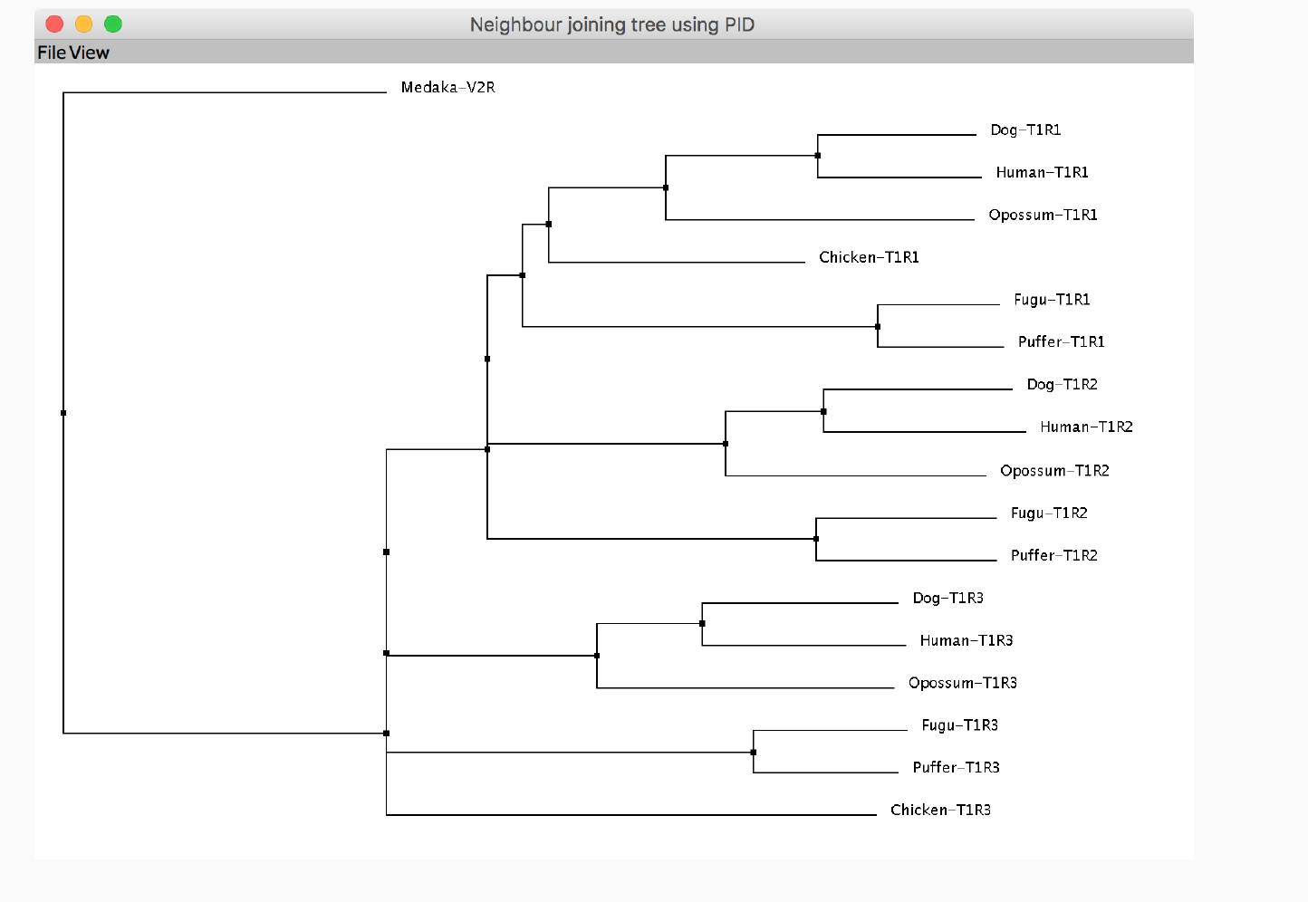

Slide 22


Well done on completing this workshop!

